Slide 1

Python Session

Slide 2
What is Python ?
Python is a general-purpose, dynamic, high-level, and interpreted programming language

Slide 3
Features
Easy to use and Learn
Expressive Language
Interpreted Language
Object-Oriented Language
Open Source Language
Extensible
Dynamic Memory Allocation
Wide Range of Libraries and Frameworks
Versatility
Large Community

Slide 4
Applications
Data Science
Console-based Applications
Software Development
Artificial Intelligence
IoT
DevOps
Writing scripts

Slide 5
Variables
Variable names must begin with a letter or an underscore, but they can be a group of both letters and digits
The variable's first character must be an underscore or alphabet (_).
White space and special characters (!, @, #, %, etc.) are not allowed in the identifier name. ^, &, *).
Identifier name should not be like any reserved characters.
Names of identifiers are case-sensitive.
Examples of valid identifiers: a123, _n, n_9, etc.
Examples of invalid identifiers: 1a, n%4, n 9, etc.

Slide 6
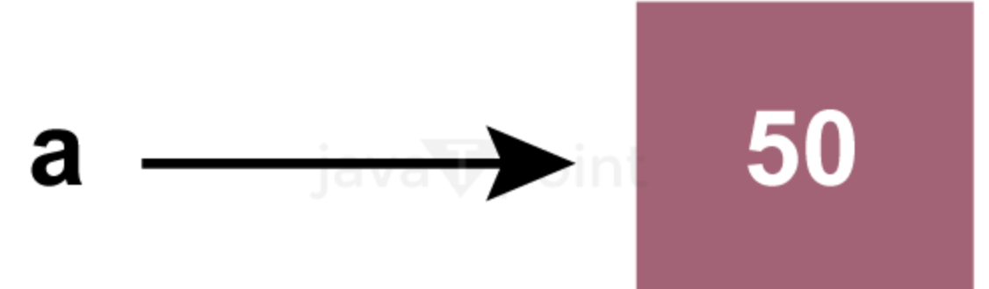
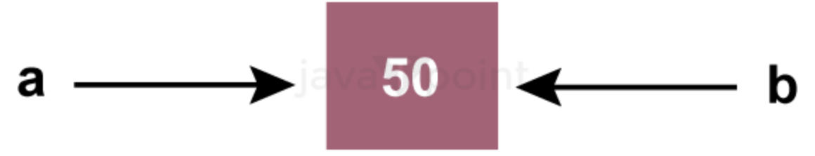
Python Variables

Slide 7
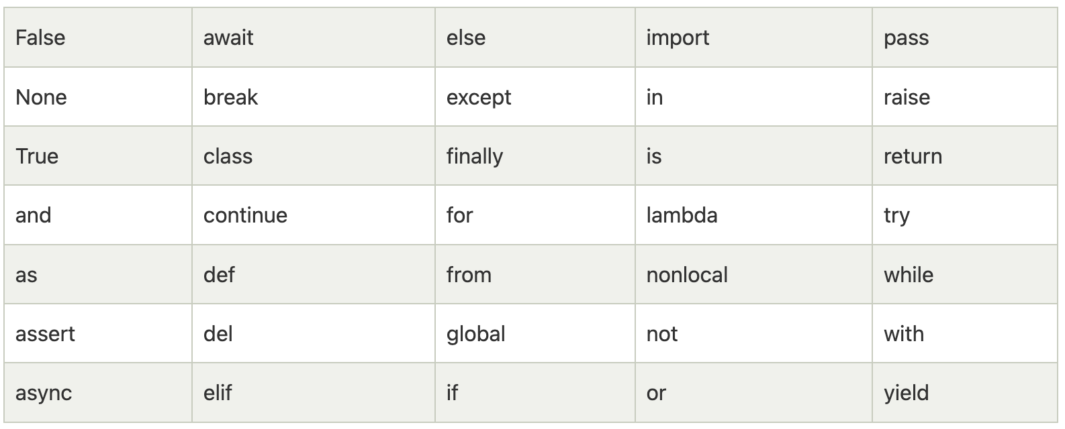
Keywords List

Slide 8
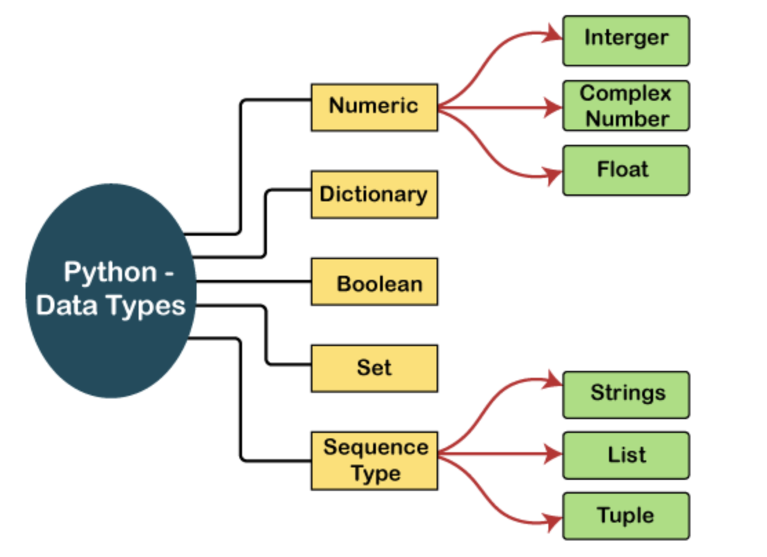
Python Data Types

Slide 9
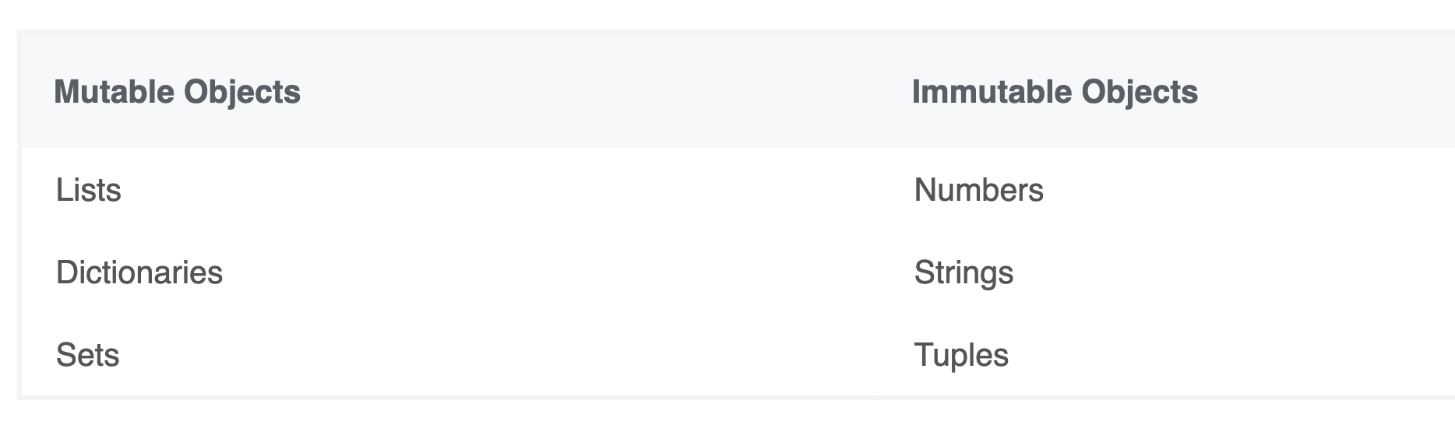
Python Mutability

Slide 10
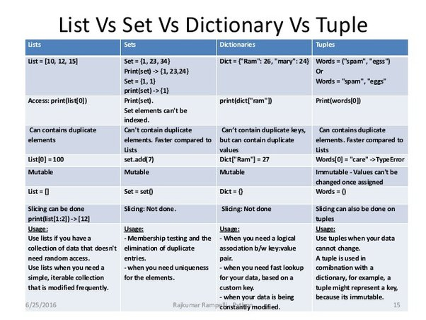
Datatype Key Differences

Slide 11
Operators
The operator is a symbol that performs a specific operation between two operands
Some of the important operators are
Arithmetic operators
Comparison operators
Assignment Operators
Logical Operators
Bitwise Operators
Membership Operators
Identity Operators

Slide 12
Indentations, Comments
Single/ Multiple line commenting
About indentations

Slide 13
Datatype operations
String
List
Tuple
Dictionary
Set
Frozenset

